Slide 1
caDSR 3.0 Sentinel Tool
Presented December 2004 to
Peter Covitz

Slide 2
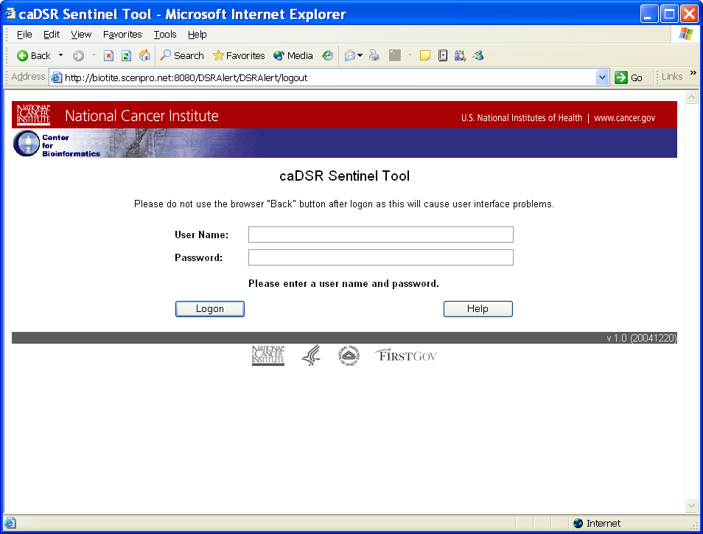
Logon

Slide 3
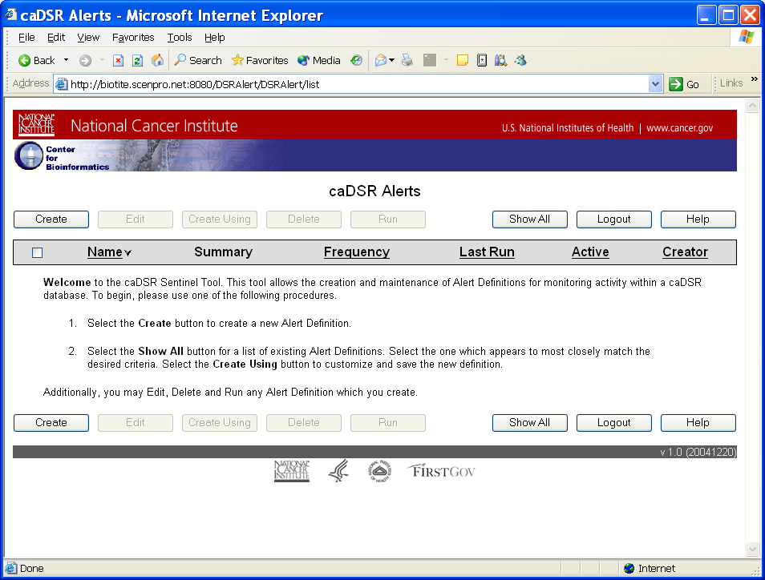
Intro for First Time User

Slide 4
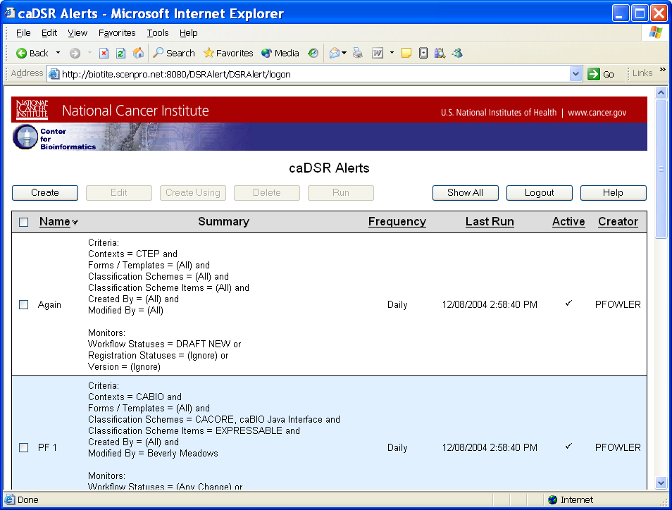
Returning User

Slide 5
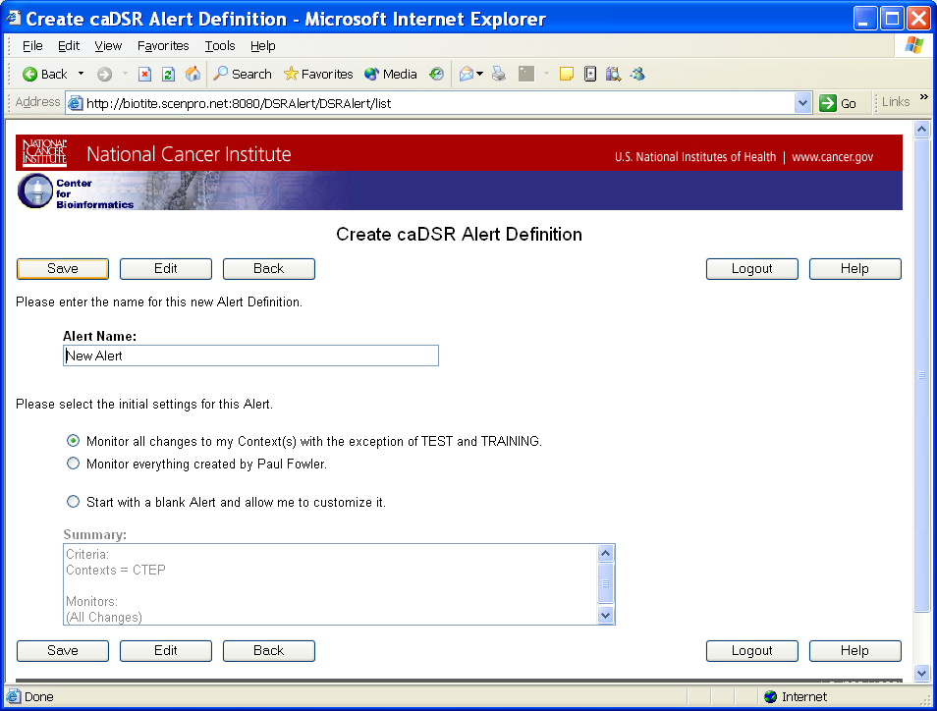
Create a New Alert

Slide 6
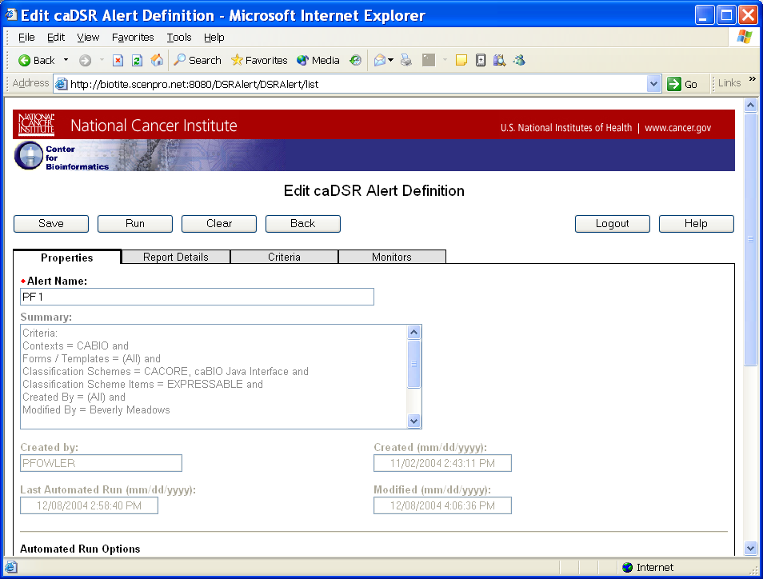
Edit - Properties Tab

Slide 7
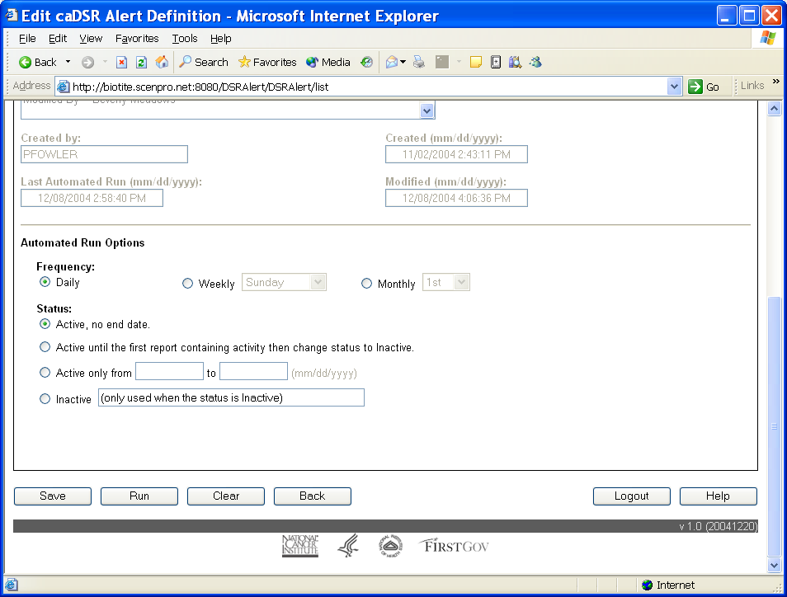
Edit – Properties Tab

Slide 8
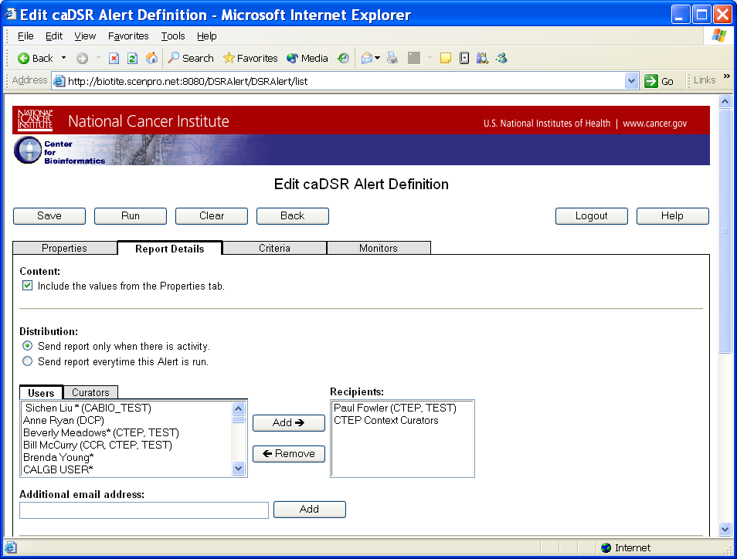
Edit – Report Details

Slide 9
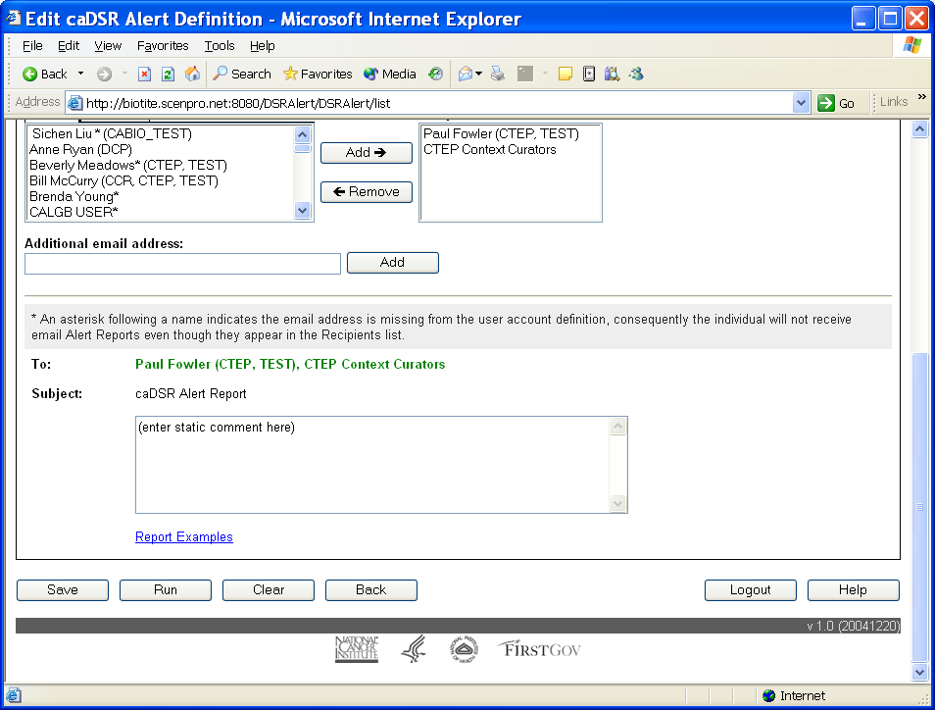
Edit – Report Details

Slide 10
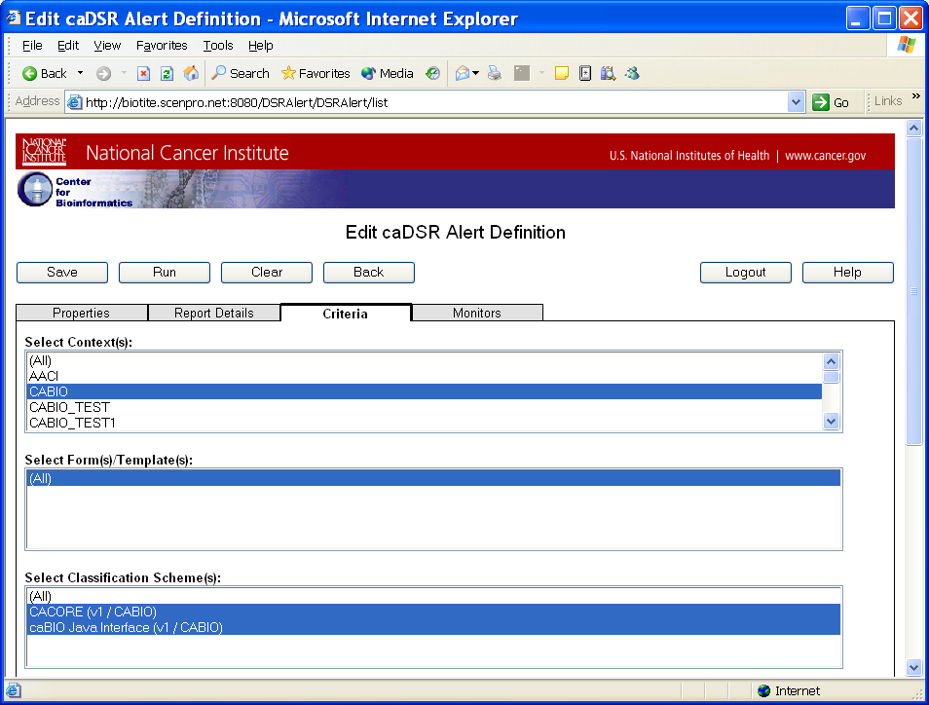
Edit - Criteria

Slide 11
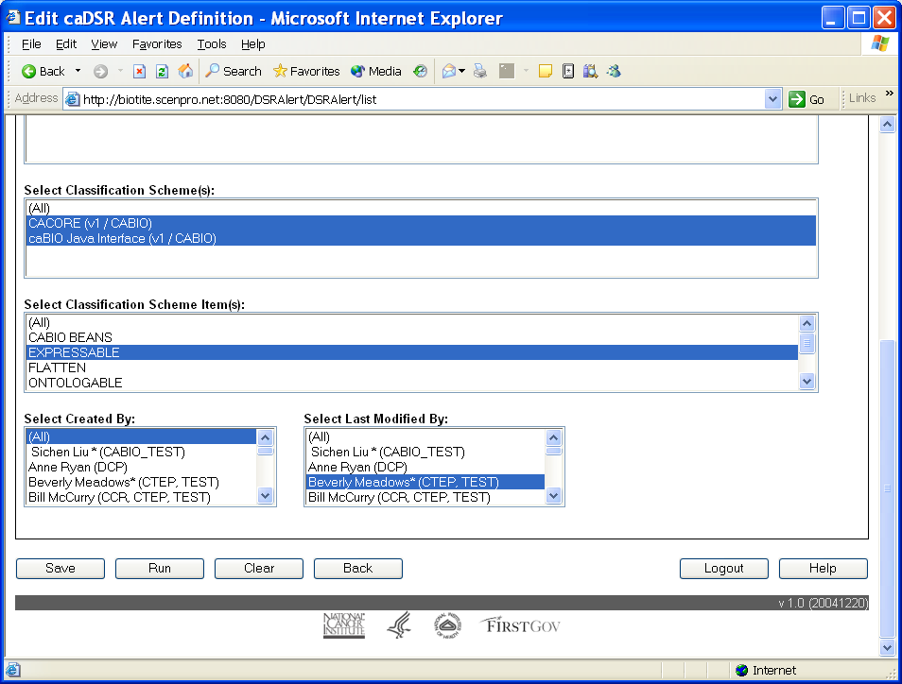
Edit - Criteria

Slide 12
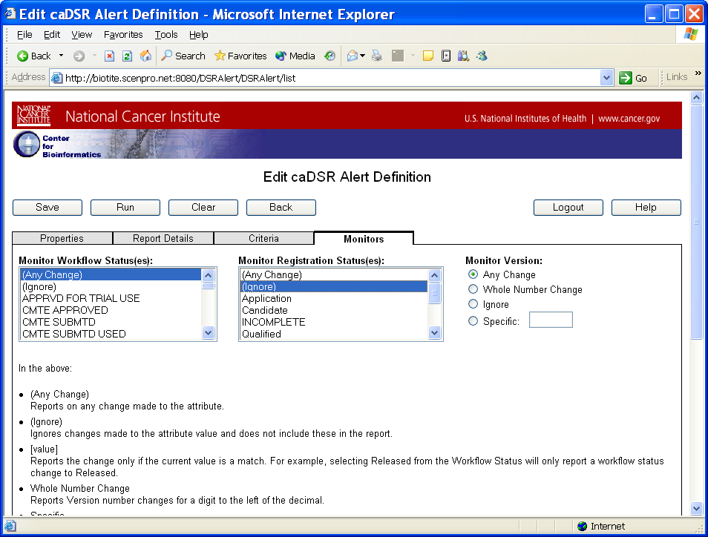
Edit - Monitors

Slide 13
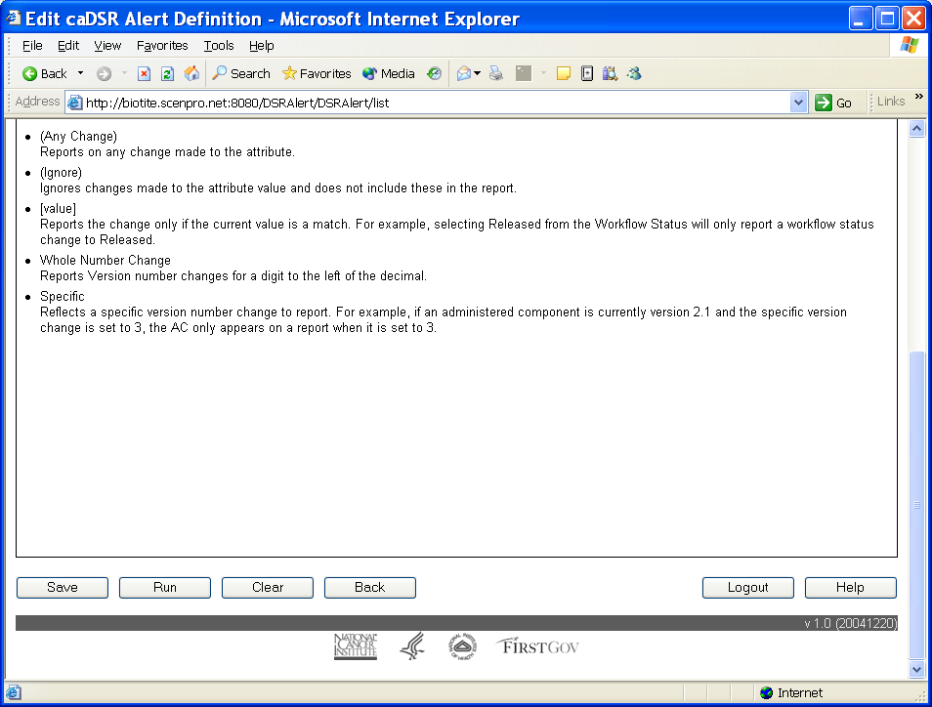
Edit - Monitors

Slide 14
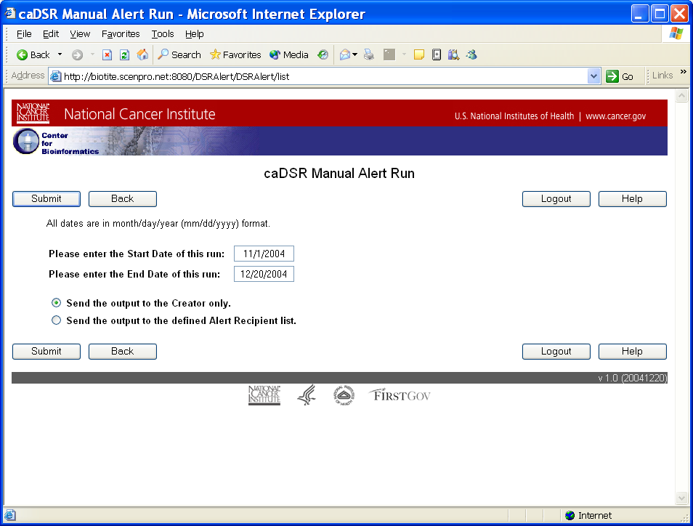
Manual Run

Slide 15
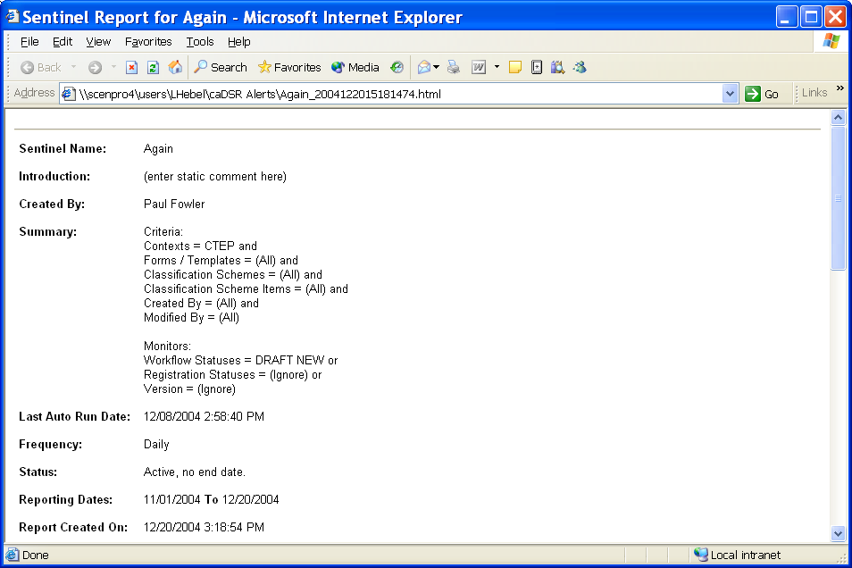
Report Header

Slide 16
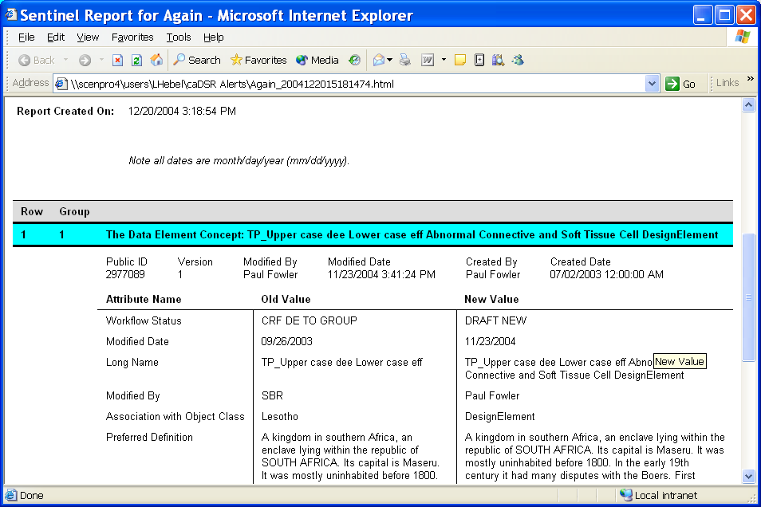
Report Body

